Slide 1
CSC 570 I Web Services
CRUD OPERATIONS INVOLVING DOCTORS/PATIENTS INFORMATION
- : Under the Esteemed Guidance: -
Dr. Kamyar Dezhgosha
- : Submitted By : -
Prateek Mulye

Slide 2
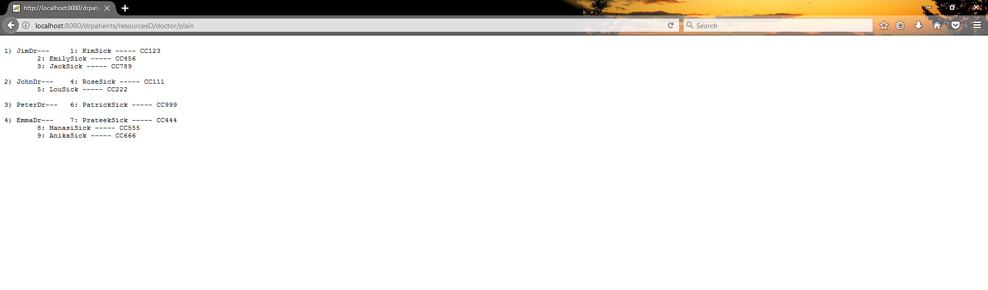
Getting the list of all the doctors along with there patients in XML and Plain text.
Plain Text

Slide 3
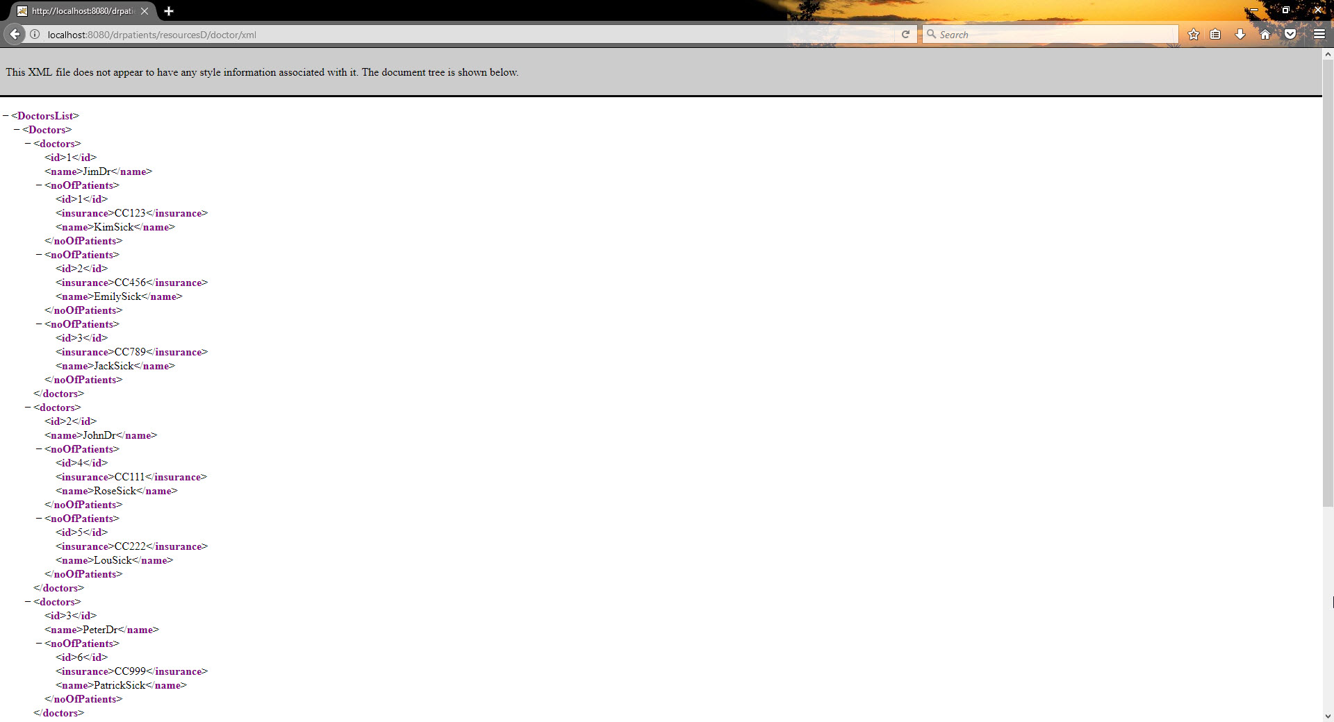
XML

Slide 4
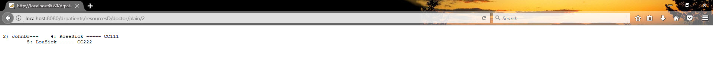
Getting the list of an individual doctor and his/her patients in XML and Plain Text.
Plain Text

Slide 5
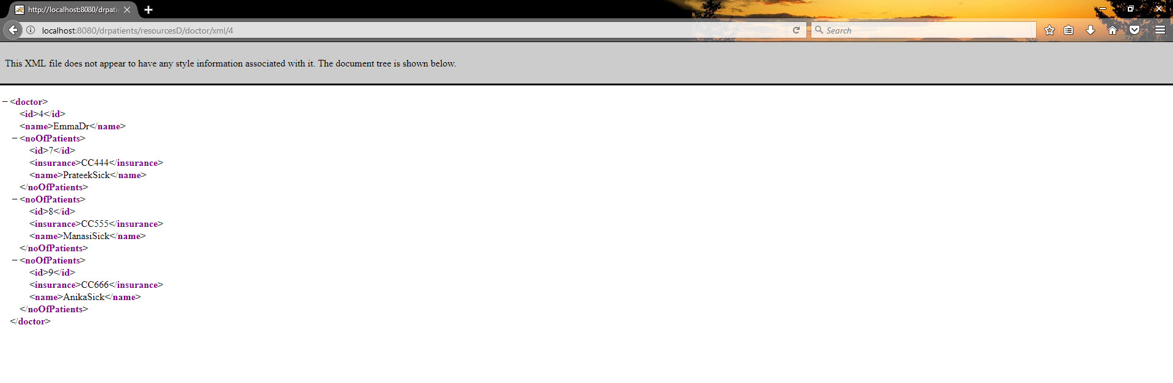
XML

Slide 6
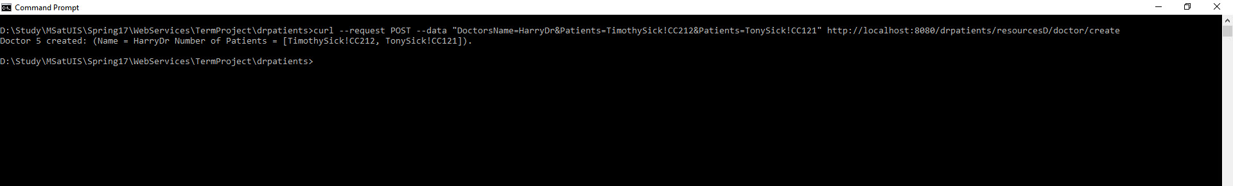
Adding or creating a new doctor along with his/her patients to the existing list.
Curl Utility

Slide 7
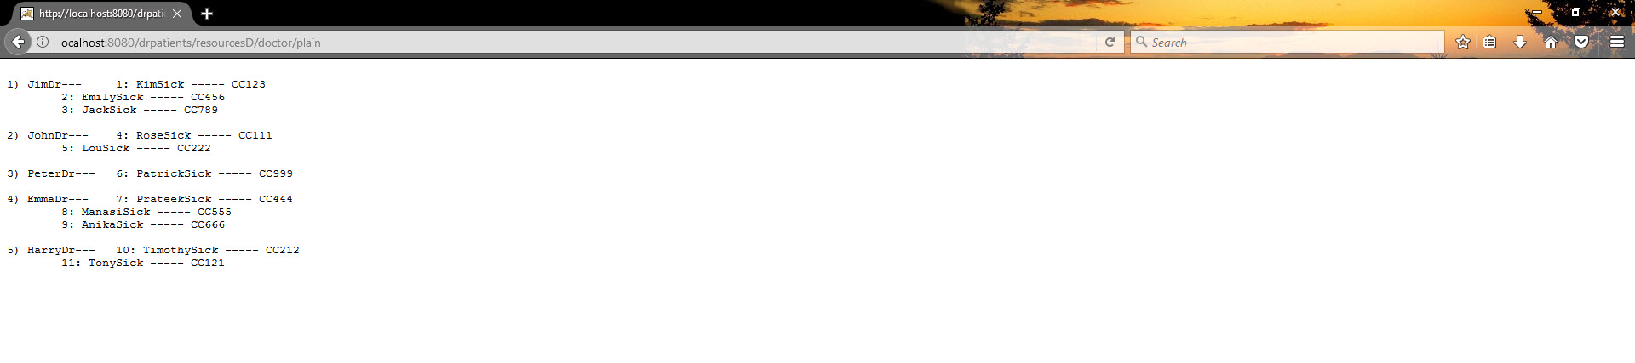
Plain Text

Slide 8
Update a doctors name only on an existing list of doctor-patients.(given ID and name)
Before Update

Slide 9
Curl Utility
Updating the Doctor’s name having an ID 3

Slide 10

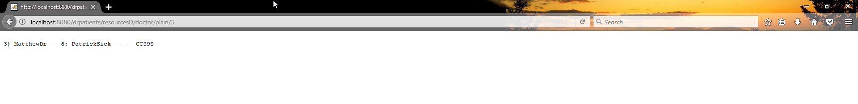
Plain Text After Update
Plain Text Single doctor

Slide 11
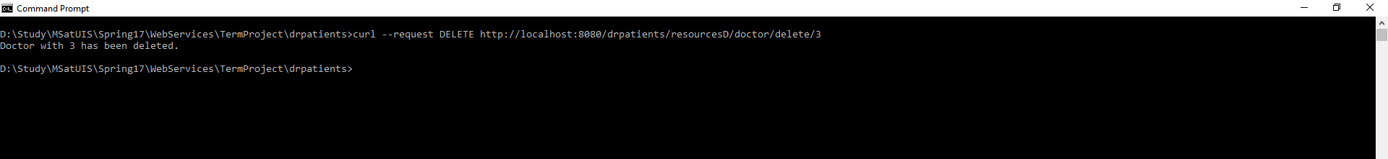
Delete or Remove an existing doctor along with his/her patients. (Given an ID)
Curl Utility
Deleting the doctor along with his/her patients having ID 3

Slide 12
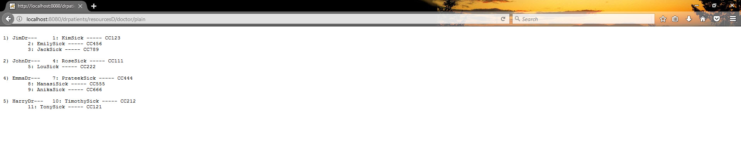
Plain Text

Slide 13
Thank You.

